Slide 1
Market Sales Visualization Dashboard
This is the landing page for your interactive Power BI report, giving users an immediate idea of the purpose, scope, and navigation structure of your dashboard.
Shraddha S

Slide 2
✨ Introduction
This interactive Market Sales Visualization Dashboard serves as a comprehensive tool for analyzing the company's sales performance.
Sets the tone for the report.
Explains the objective in simple yet strategic language.
Emphasizes that this is a data-driven decision support system.
Lets stakeholders know they can expect insights across sales, products, customers, and regions.

Slide 3
🎯 Purpose of the Dashboard
Enable executives to make data-driven decisions.
Executives get high-level KPIs.
Product managers see product performance & inventory patterns.
Marketing teams gain insights into customer behavior.
Gives confidence that the dashboard serves strategic business needs

Slide 4
🧭 Navigation Guide
Overview: Summarizes overall sales, top-performing regions
Provides a roadmap to the sections within the dashboard.
Product Analysis: Deep dives into product sales & trends.
Customer Segmentation: Buyer demographics, behavior, and contribution.
Geospatial View: Map-based visualizations showing where revenue comes from.

Slide 5
Summary of Insights
The dashboard provided a comprehensive overview of sales performance across multiple dimensions including product lines, customer demographics, and regional markets.
Top-performing products and high-revenue regions were identified, allowing strategic focus on expansion opportunities.
Customer segmentation revealed valuable insights into buying patterns and target demographics.
Geospatial analysis uncovered untapped markets and helped visualize the effectiveness of sales strategies regionally.

Slide 6
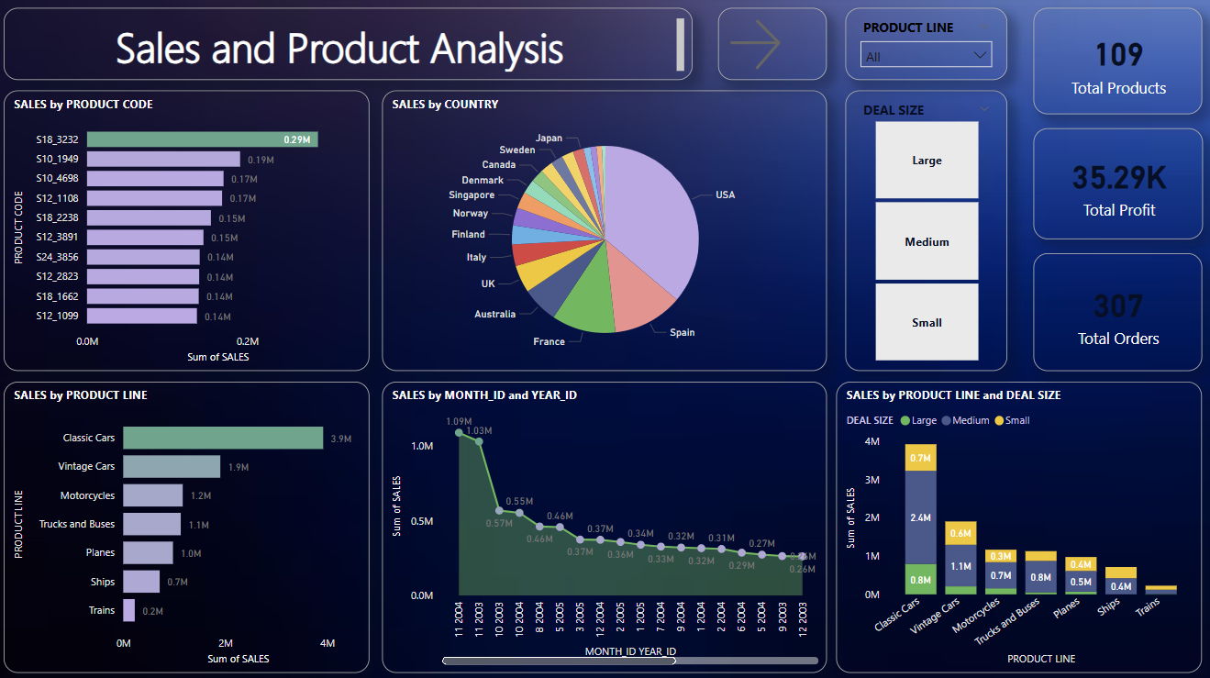

Slide 7
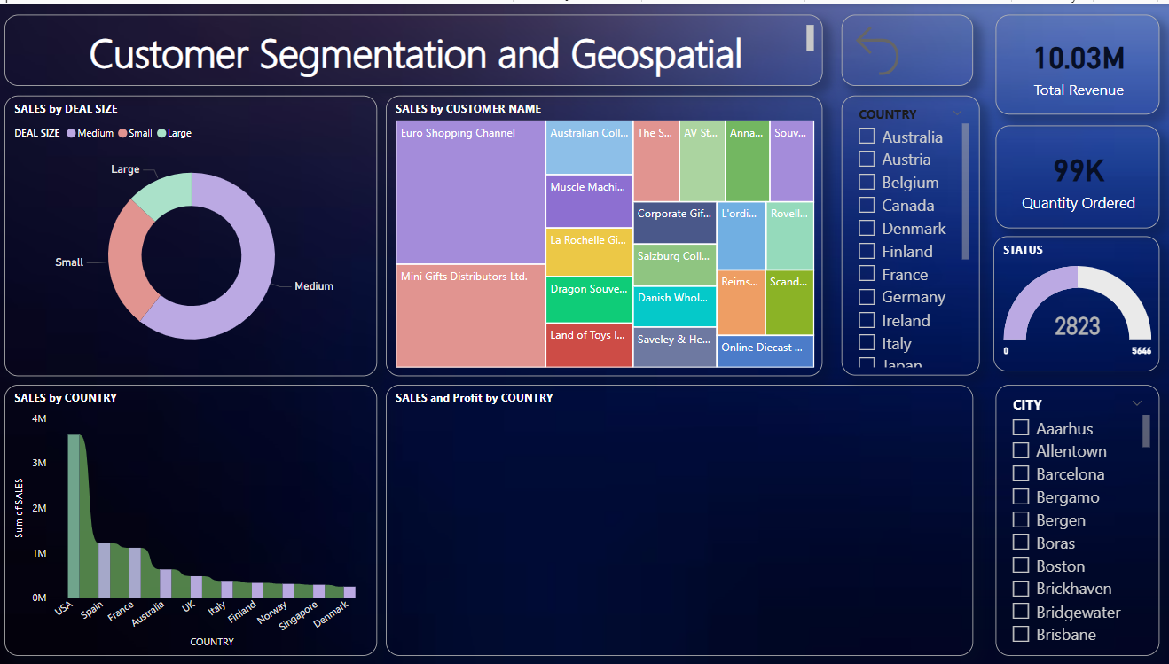

Slide 8
Key Takeaways
Data visualization simplifies complex data, making it easier for decision-makers to understand performance at a glance.
Interactive elements such as filters and drill-downs enable personalized and detailed analysis.
The tool supports cross-functional teams—marketing, product, and sales—to collaborate using a single source of truth.

Slide 9
Recommendations
Focus marketing efforts on high-converting customer segments identified through segmentation.
Consider stock optimization for best-selling and seasonal products highlighted in product analysis.
Expand presence in underperforming but high-potential regions based on the geospatial trends.

Slide 10
Thank You

